Slide 1
Image Processing
Gray-level Binary Fonts
Image halftoning using Gray-level binary fonts transforms an image with L number of gray levels into an image with N perceived gray levels. N matrices are created and for each pixel, the appropriate matrix is copied at the appropriate position of the output image.
For this exercise you are tasked to perform image halftoning using gray-level binary fonts on a greyscale image.

Slide 2
Image Processing
Gray-level Binary Fonts
The algorithm takes as input a grayscale image and a number of halftones, which will decide the amount of perceived gray levels of the image. It counts the number of halftones of each pixel and changes the value of that number of neighboring pixels to 255.
Finally, it returns the halftoned image and displays it alongside the original one.

Slide 3


Image Processing
Gray-level Binary Fonts
Input example.
Intermediate output example (number of halftones is 10).

Slide 4
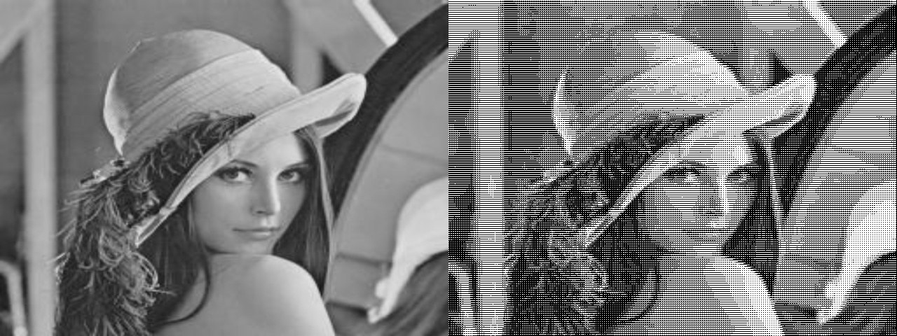
Image Processing
Gray-level Binary Fonts
Output example (number of halftones is 10).

